Slide 1
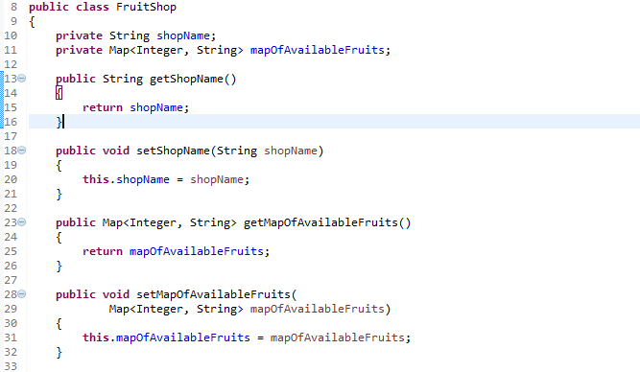
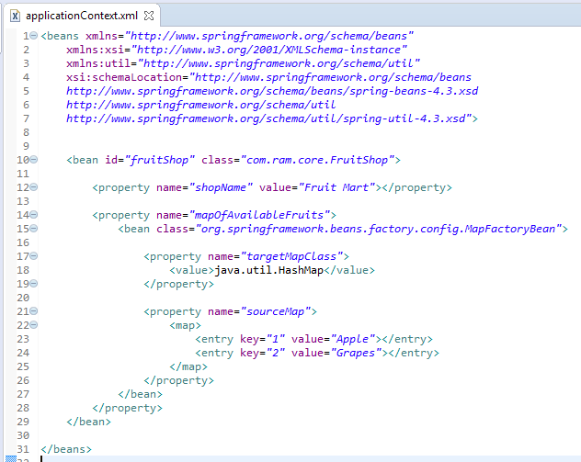
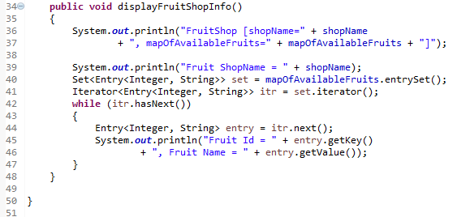
MapFactoryBean to create a concrete Map collection class (HashMap and TreeMap)
We can use MapFactoryBean to create a concrete Map collection class (HashMap and TreeMap) in Spring’s bean configuration file.
MapFactoryBean will instantiate an HashMap at runtime, and inject it into a bean property.

Slide 2
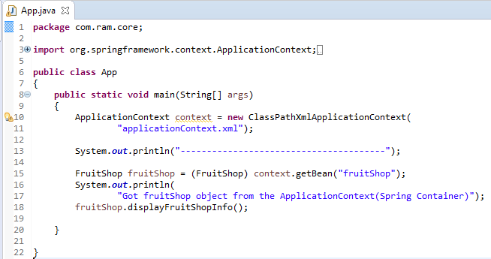
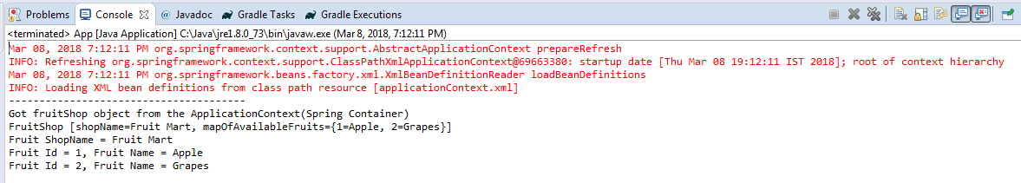
MapFactoryBean to create a concrete Map collection class (HashMap and TreeMap)

